Slide 1

Modern JavaScript(ES6)

Slide 2
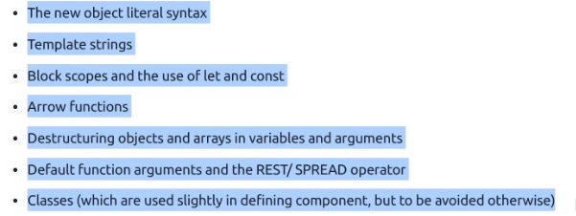
Overview

Slide 5
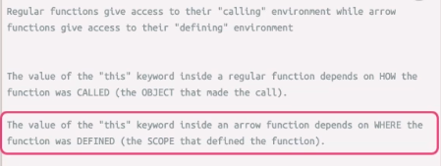
Arrow Functions

Slide 7
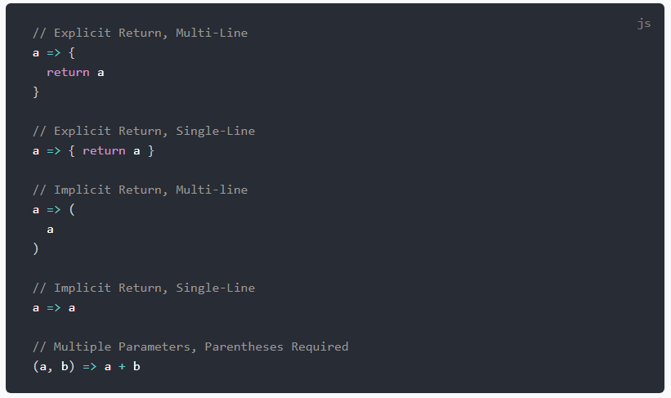
Arrow Functions CheatSheet

